Slide 1
HỒ MINH KHÔI
Class Diagrams, General design of logic, Implementation of cell components & functions, Main menu, Action events of main, Help menu, Final version of Media player, Editing for component view & videos, Final report
25
TRẦN NGỌC KHÁNH
TEAM 13
Demonstration of Cell Division
Media player (first version), Component view: Animal + Fungi, Videos required for Media player, report outline, slide template
TRẦN QUỐC KHÁNH
Linking action event, quit function, Media player (second version), Component view: Plant + Protist, Videos required for Media player and edit, report outline, slide template
1
TRẦN CÁT KHÁNH
Use Case diagram, album view and images, Component view: Prokaryotes, Report: References & OOP techniques, Final slides
https://www.youtube.com/watch?v=XCg1tfyJsj4
2

Slide 2

INTRODUCTION
The mission of our project is to build an application which visualizes the cell division process of 2 types of cells, Prokaryotic cells and Eukaryotic cells, as well as visualizing components of the cells and their functions.
4

Slide 3
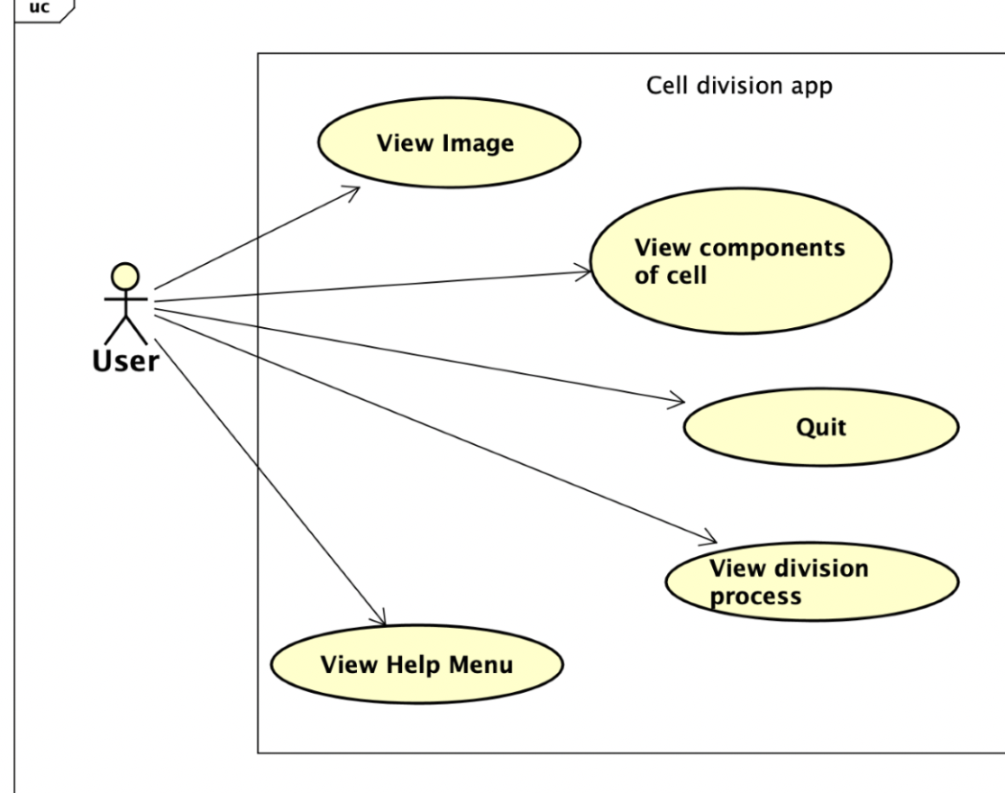
USE CASE DIAGRAM
10
45
70
4

Slide 4
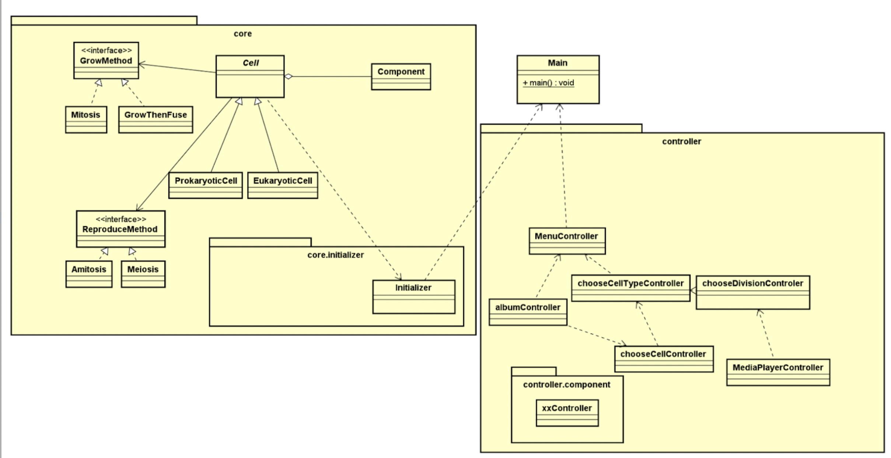
GENERAL CLASS DIAGRAM
3

Slide 5
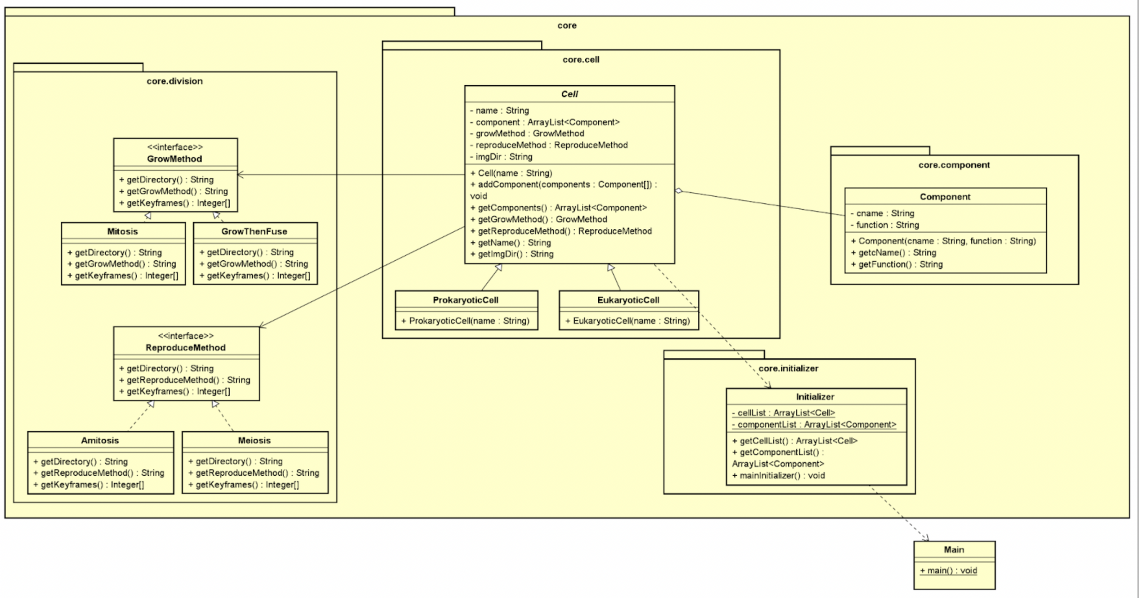


PACKAGE CLASS DIAGRAM
6

Slide 6
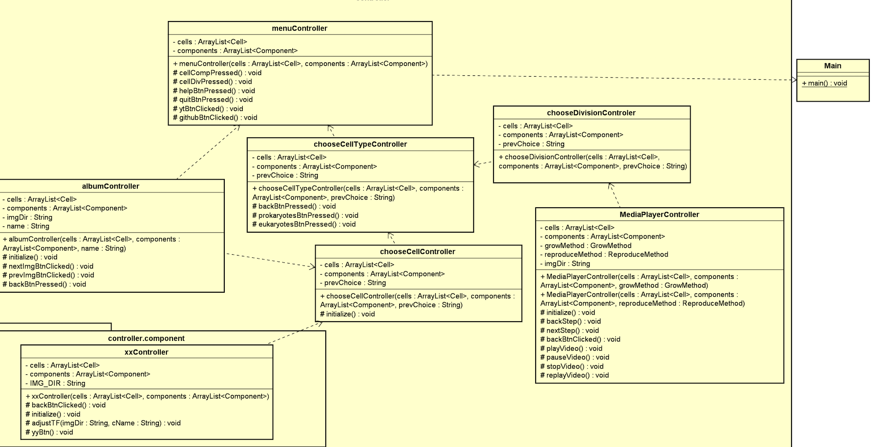
PACKAGE CLASS DIAGRAM

Slide 7

OOP TECHNIQUES
Encapsulation
Major attributes are set private for protecting information from out accessor
For example , private String name , private String imgDir,
Abstraction
abstract class Cell to prevent creating Object instance and optimize method structure
5

Slide 8

OOP TECHNIQUES
Inheritance
Class ProkaryoticCell and Class EukaryoticCell inherit from class Cell
interface: growMethod ,reproduceMethod
==> The main purpose is code reusability. The code that is present in the class Cell can be directly used by the child class
(Class ProkaryoticCell and Class EukaryoticCell)
5

Slide 9
OOP TECHNIQUES
Polymophism
When Amitosis and Meiosis implements reproduceMethod, override the methods getDirectory(),getReproduceMethod(),
getKeyframes()
Similarly , GrowThenFuse and Mitosis implements GrowMethod
==> The main purpose is that polymorphism allows to define one interface and have multiple implementations , Apply upcasting and downcasting flexibly in various usage all over the appication
5

Slide 10
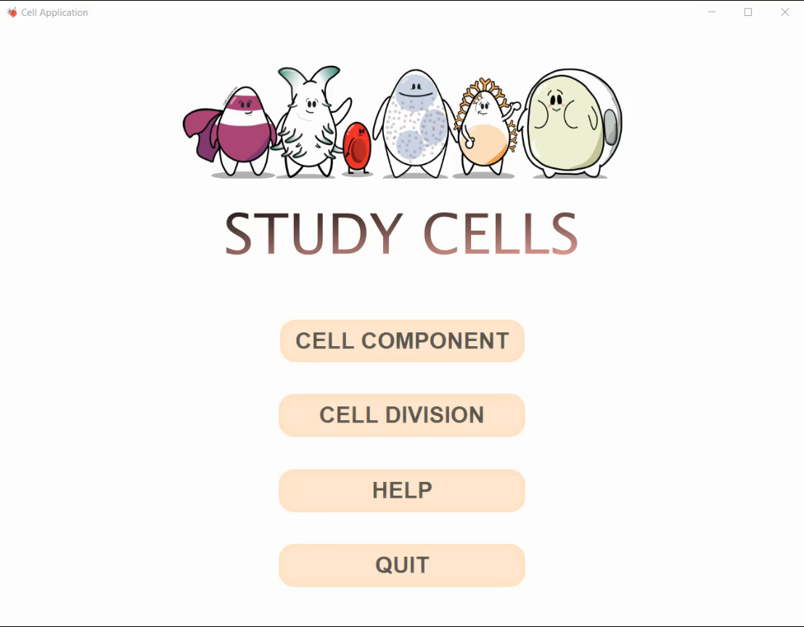
DEMO
https://www.youtube.com/watch?v=XCg1tfyJsj4
4

Slide 11



THANKS FOR LISTENING
khanh.tc204916@sis.hust.edu.vn
15

